Slide 1
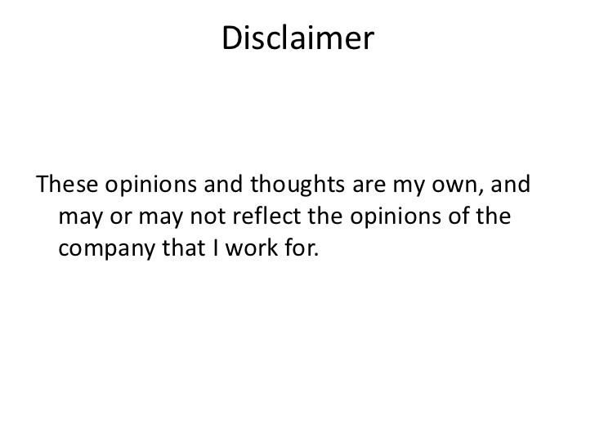

Slide 2

Week 1: AI Concepts
zhangan@amazon.com
Amazon Web Services
RBS – Jan 23, 2021

Slide 3
Agenda
Introduction to AI (30 mins)
Python Data Analytics (30 mins)
Syllabus and Logistics (45 mins)
Q/A: Why you are here?
Guest Speaker (?)

Slide 4
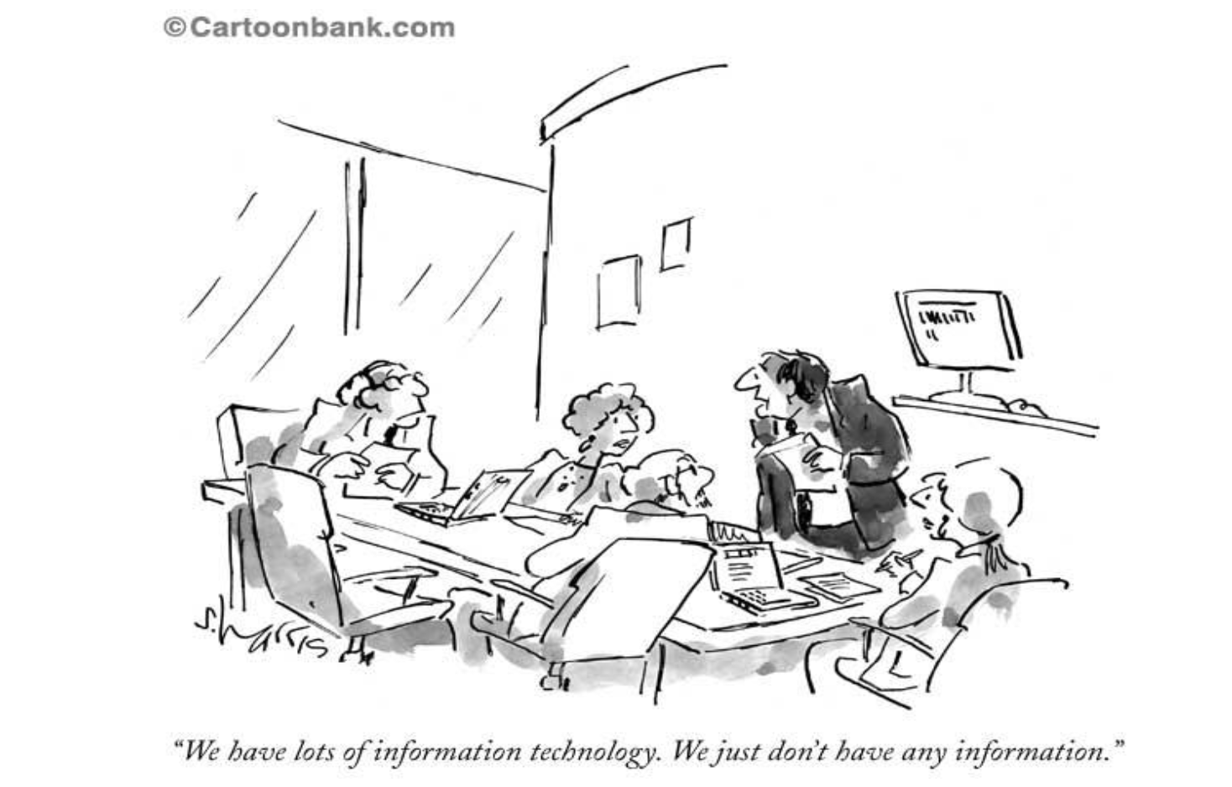
About me
Open Source
Big Data Analytics
Data and AI
High Performance Computing

Slide 5
Introduction

Slide 6
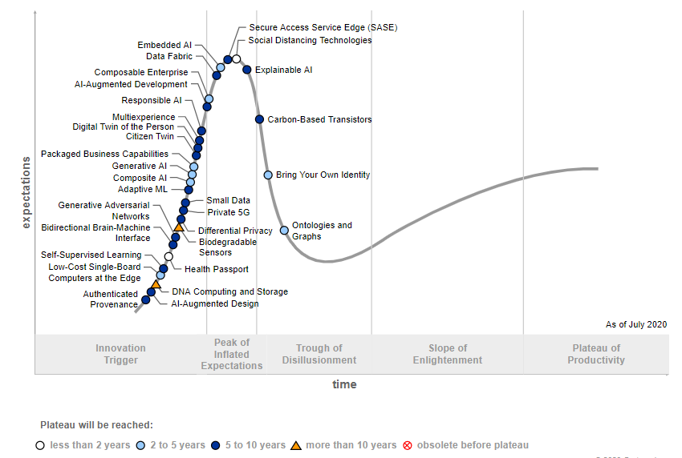
Future of Technologies
1. Cloud
2. Data
3. Artificial Intelligence

Slide 7

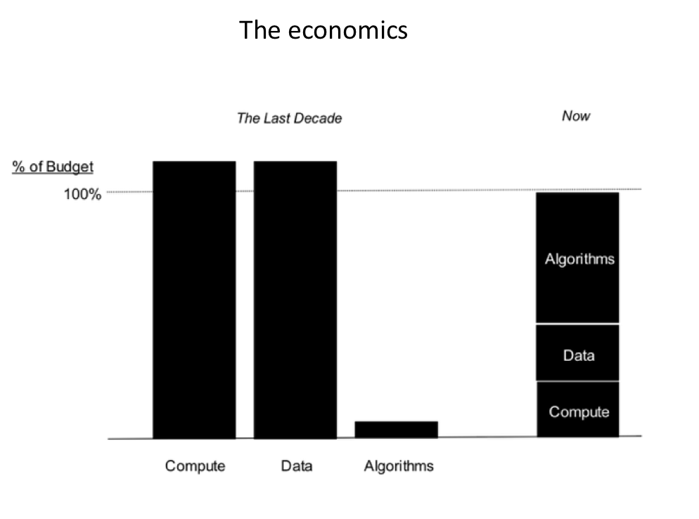
Why Data and AI, Why Now?

Slide 8
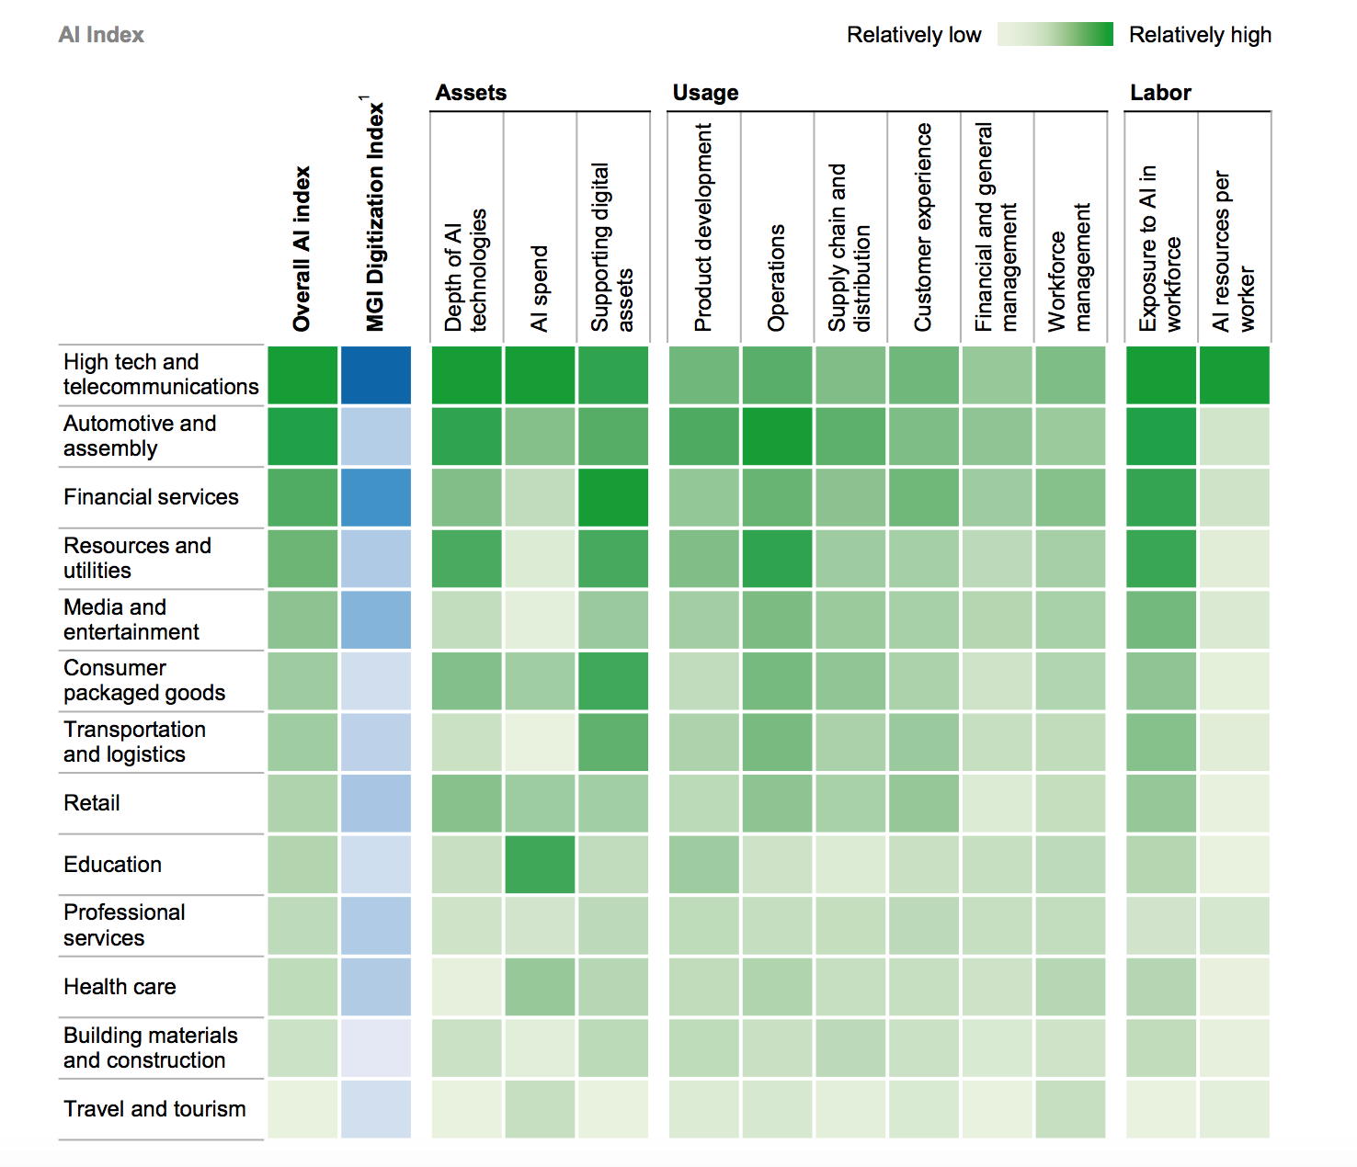
Data and AI Opportunities Everywhere
McKinsey Global Institute

Slide 9
Why are enterprises struggling to capture the value of Data and AI?
Data
Data resides in silos & difficult to access
Unstructured and external data wasn’t considered
Governance
If the data isn’t secure, self-service isn’t a reality
Challenge understanding data lineage and getting to a system of truth
Skills
Data Science skills are in low supply and high demand
Nurturing new data professionals is challenging
Tools & Infrastructure
Need an environment that enables a “fail fast” approach
Discrete tools present barriers to productivity

Slide 10
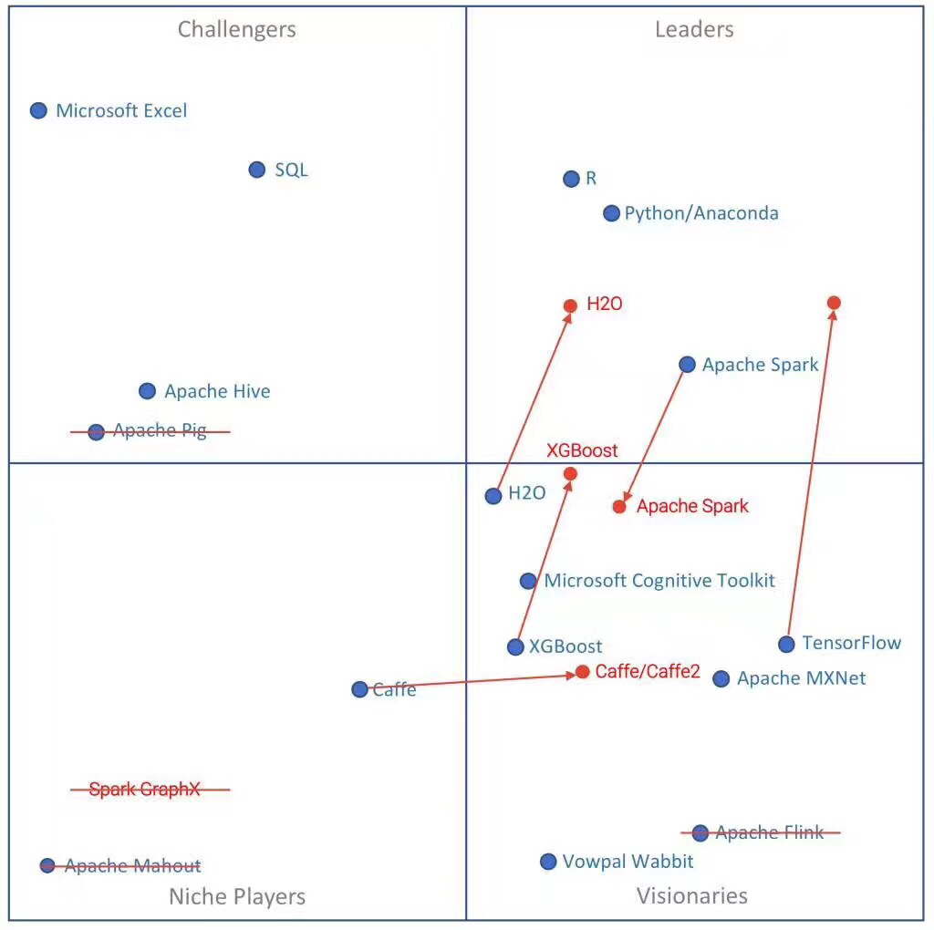
Data Analytics Magic Quadrant 2018
Notes:
The current state of #datascience tools in 2021:
Databases and SQL go hand in hand. Cloud SQL, column based stores and NOSQL (not only SQL) for unstructured datasets will ensure SQL is a must have skill for the foreseeable future.
Self service BI tools like Tableau, PowerBI, Alteryx are used to reduce time taken to create beautiful and impactful data visualisations for reportinf, insights & analysis.
All purpose languages such as Python, R and increasingly Julia are used to analyse data via notebooks, build interactive dashboards and create machine learning & statistical models.
Python appears to have the edge when it comes to deep learning and integration with various cloud computing platforms.
Big data frameworks based on the JVM (Java) are still used for big data processing - the most popular being Spark Scala or PySpark.
Most data storage & processing tasks are being moved to the cloud - often with a heavy focus on data integrity and lineage.
Cloud SQL is used to migrate ETL processes, some key players: Snowflake, BigQuery, Redshift amongst others
MLOps and autoML tools such as DataRobot, MLFlow, Kubeflow, H20 etc are used to deploy and maintain machine learning models.
This is super brief but I hope this helps - let me know if I’ve missed anything!
#DataWithDanny

Slide 11
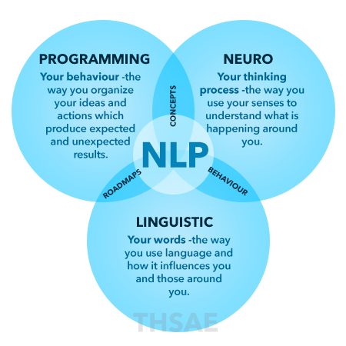
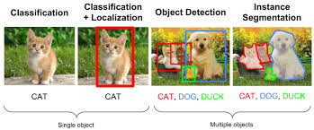
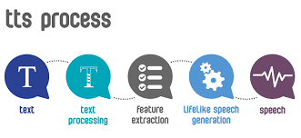
Popular Machine Learning Services
NLP
Natural Language Processing Services
Entity Extraction
Key Phrase Extraction
Sentiment Analysis
Syntax Analysis
Topic Modeling
Multiple Language Support
Parts of Speech
Visual Recognition
Object Detection
Scene Detection
Facial Recognition
Flag In-appropiate Content
Facial Analysis
Celebrity Recognition
Logo Detection
Text Recognition
Web Detection
Landmark Detection
Dominant Color Detection
Thumbnail Generation
Speech
SSML
Multiple Language
Format
Automatic Speech Recognition (ASR)
Noisy Accuracy
Machine Learning (ML) Services from Various Cloud ML Service Providers

Slide 12
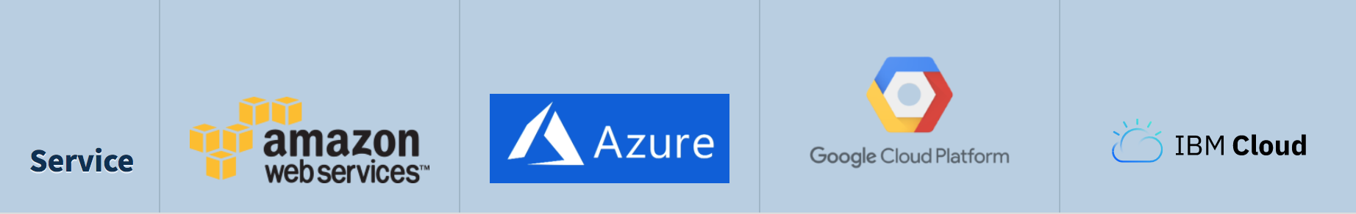
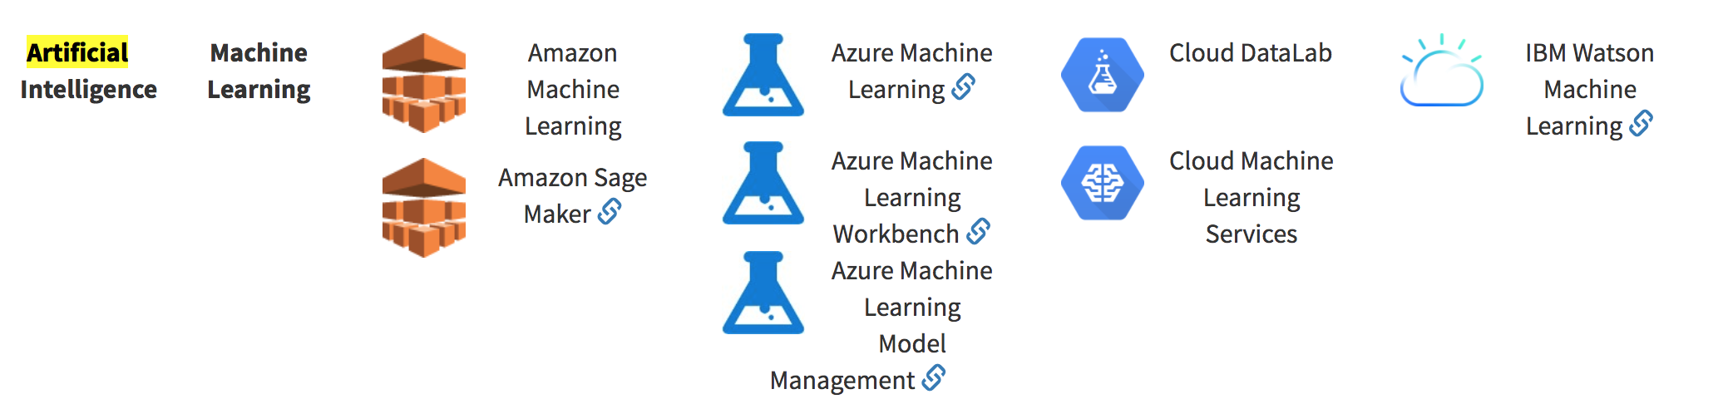
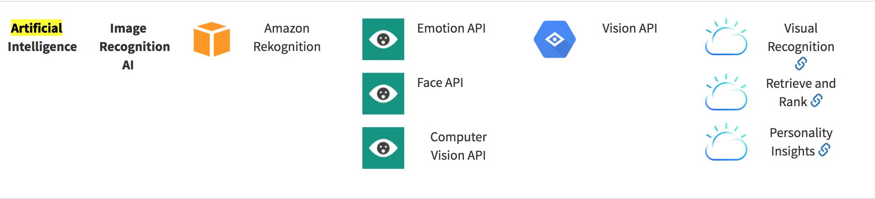
ML Cloud Platforms
Trends
Trend #1: Special tool for special task
Trend #2: More robust open and build-in algorithms
Trend #3: From public cloud to on-premise
Choose a vendor/tool
Ecosystem
Talent
Cost & Performance
Product Features (20-30~ +)
Train and Build Model
Deploy and Evaluate Model
Cognitive APIs (20-30+)
Distribute and scale ML/DL
Bias and Explainability
Highlights
Azure ML Studio
Amazon SageMaker
Google AutoML
IBM Watson Studio

Slide 13
Python Data Analytics

Slide 14

Introducing Python
"Python is powerful... and fast; plays well with others; runs everywhere; is friendly & easy to learn; is Open."
What You Can Do With Python
#1: Automate the Boring Stuff. ...
#2: Stay on Top of Bitcoin Prices. ...
#3: Create a Calculator. ...
#4: Mine Twitter Data. ...
#5: Build a Microblog With Flask. ...
#6: Build a Blockchain. ...
#7: Bottle Up a Twitter Feed. ...
#8: Play PyGames.
https://www.python.org/
Notes:
Home Page, Applications, Audio/Talks, Events

Slide 15



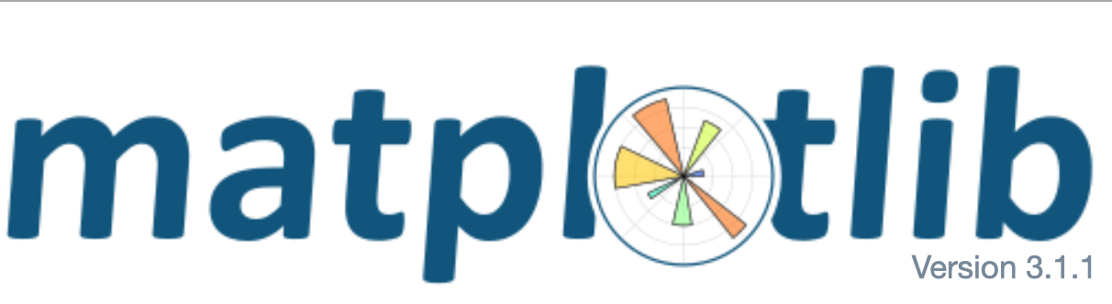


Data Analytics with Python
https://www.python.org/
Notes:
Home Page, Applications, Audio/Talks, Events

Slide 16
A fast and efficient DataFrame object for data manipulation
Reading and writing data : CSV and text files, Microsoft Excel, SQL databases, and the fast HDF5 format
Data alignment and handling of missing data
Reshaping and pivoting of data sets
Slicing, indexing, and subsetting of large data sets
Group by, merging and joining of data sets;
Python with pandas is in use in a wide variety of academic and commercial domains, including Finance, Neuroscience, Economics, Statistics, Advertising, Web Analytics, and more.
https://pandas.pydata.org/
https://pandas.pydata.org/pandas-docs/stable/user_guide/10min.html
Notes:
Documents, Talks,

Slide 17
Python 2D plotting library which produces publication quality figures
Interactive environments with Python shell, IPython, Jupyter notebook, and web application servers
Generate plots, histograms, bar charts, scatter plots, etc., with just a few lines of code
Simple plotting pyplot module provides a MATLAB-like interface
Full control of line styles, font properties, axes properties
https://matplotlib.org/
Notes:
Examples, Pyplot Examples

Slide 18
Most popular machine learning library in Python
Built on NumPy, SciPy, and matplotlib
Classification: Identifying to which category an object belongs to such as spam detection, image recognition
Regression: Predicting a continuous-valued attribute associated with an object such as energy consupmption, stock price
Clustering: Automatic grouping of similar objects into sets such as customer segmentation and grouping experiment outcome
Dimensionality reduction: Reducing the number of random variables to consider such as visualization, increased efficiency
https://scikit-learn.org/stable/
Notes:
Documents -> Flow Chart,

Slide 19
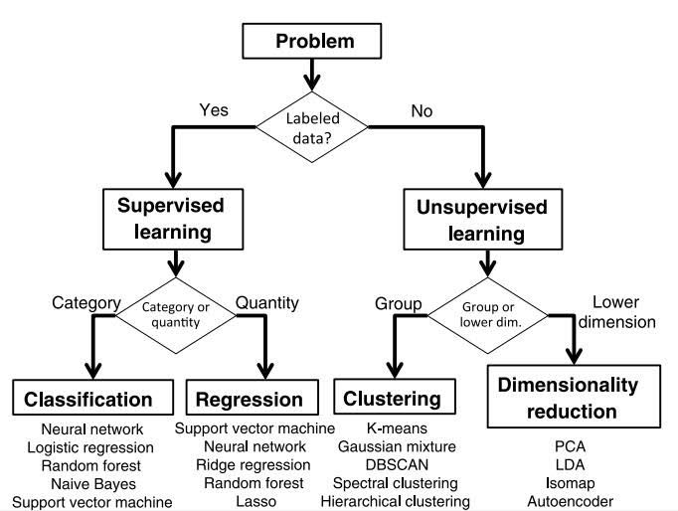
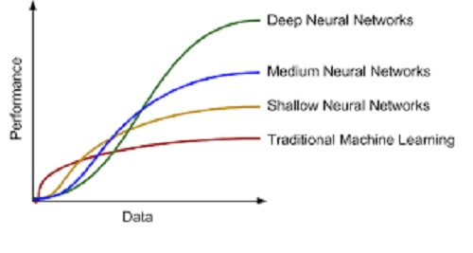
Machine Learning vs Deep Learning
Machine Learning
Traditional ML requires manual feature extraction/engineering
Feature extraction for unstructured data is very difficult
Deep Learning
Deep learning can automatically learn features in data​
Deep learning is largely a "black box" technique, updating learned weights at each layer

Slide 20

Download & Install Anaconda
https://www.anaconda.com/distribution/

Slide 21
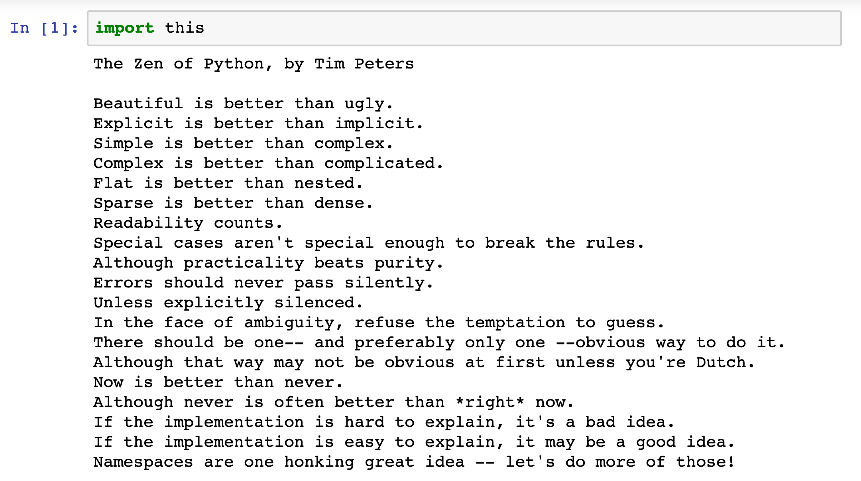
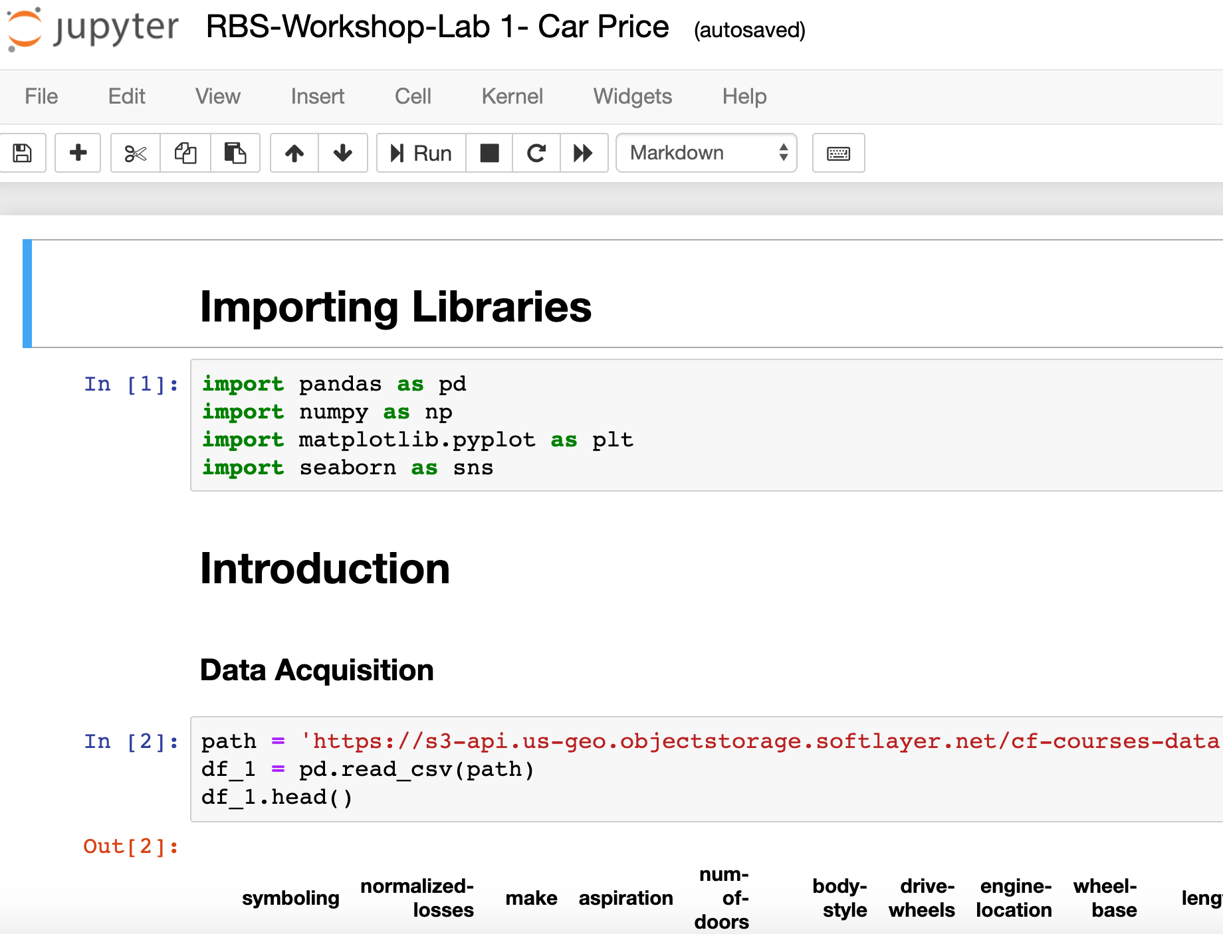
Jupyter Notebook

Slide 22
Syllabus

Slide 23
Questions ?

Slide 24
Takeaways
Top 10 Python libraries of 2020
Bar Chart Race in Python with Matplotlib

